Slide 2
Lumière de Vie® 護膚美麗革命
Lumière de Vie®
Rose Wong
總顧問經理級 National Supervising Coordinator
四個佣金週期共賺取HK$76,600
HK$76,600 in 4 Commission weeks
極緻研亮護膚系列
本簡報中提到的收入等級純屬舉例說明，無意代表美安香港超連鎖店主的一般收入，也無意表示任何超連鎖店主皆可賺取同等收入。美安香港超連鎖店主的成功與否，取決於其在發展事業時的努力、才能與投入程度。The income levels mentioned in the following presentation are for illustration purposes only. They are not intended to represent the income of a typical Market Hong Kong UnFranchise Owner, nor are they intended to represent that any given Independent UnFranchise Owner will earn income in that amount. The success of any Market Hong Kong Independent UnFranchise Owner will depend upon the amount of hard work, talent, and dedication which he or she devotes to building his or her Market Hong Kong Business.

Slide 3
極緻研亮護膚系列

Slide 4
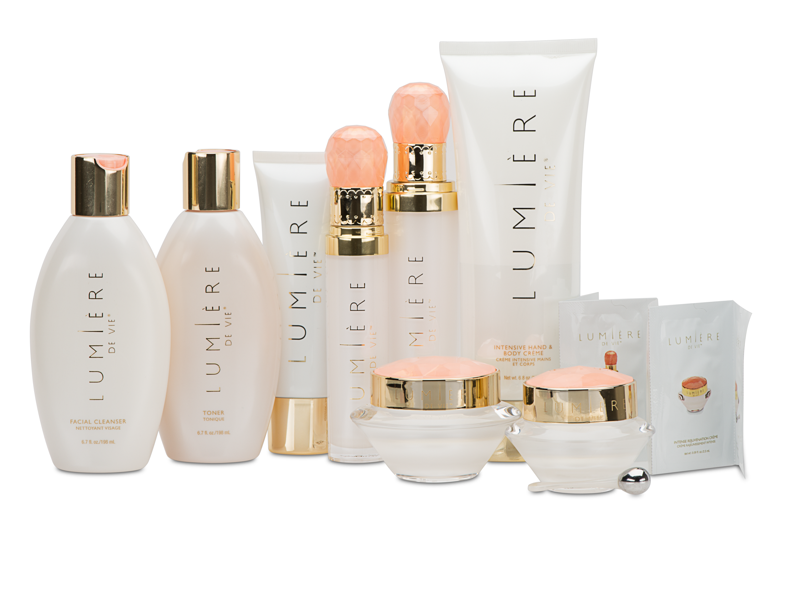

Slide 5
兩次使用後…
After 2nd applications…
上面展示的並不是必然效果。見證效果因人而異。Results shown above may not be typical. Individual results may vary.

Slide 6
Lumière de Vie®極緻研亮護膚系列蘊藏大地與海洋的力量，令肌膚剔透明亮，煥發年輕再生光彩
Using the power of the earth and sea, Lumière
de Vie® helps provide revitalized radiance, improved clarity and younger-looking skin.

Slide 7
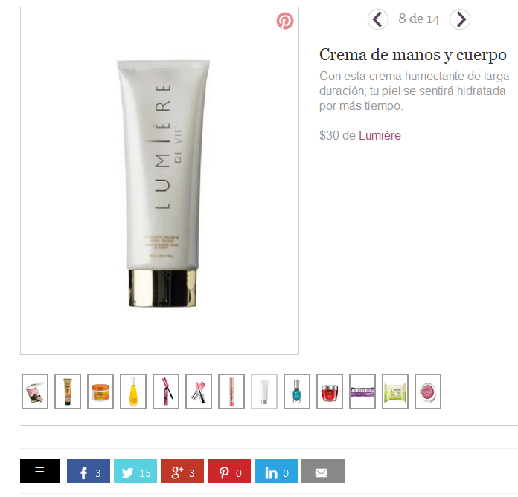
長效滋潤，令你的肌膚持久水潤
With this long lasting moisturizer, your skin will feel hydrated longer.

Slide 8
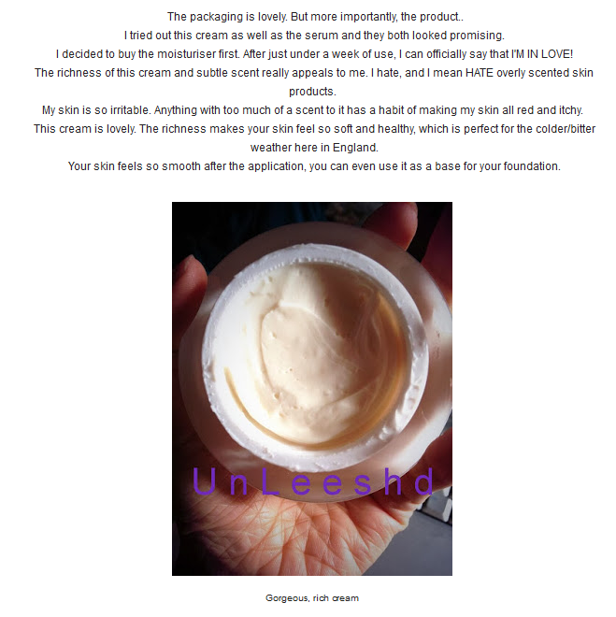
只用了一星期，我已愛上這產品！
After just a week of use, I can officially say that I’M IN LOVE!

Slide 9
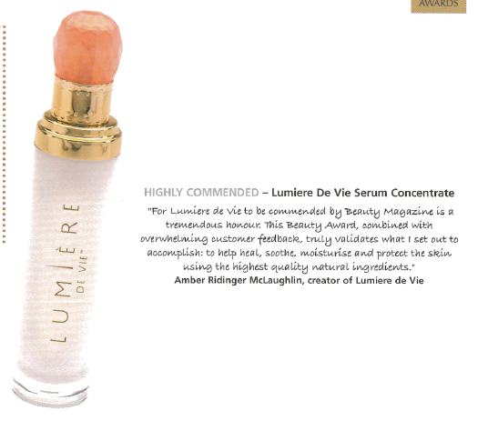
…成份優質天然，有助修護、紓緩和保護肌膚
…helps heal, soothe, moisturize and protect the skin using the highest-quality, natural ingredients.
Beauty Magazine

Slide 10
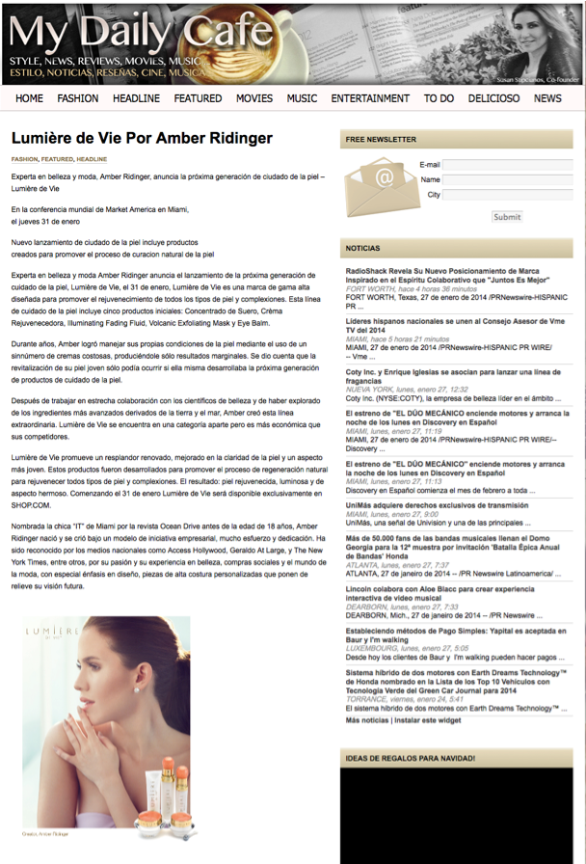
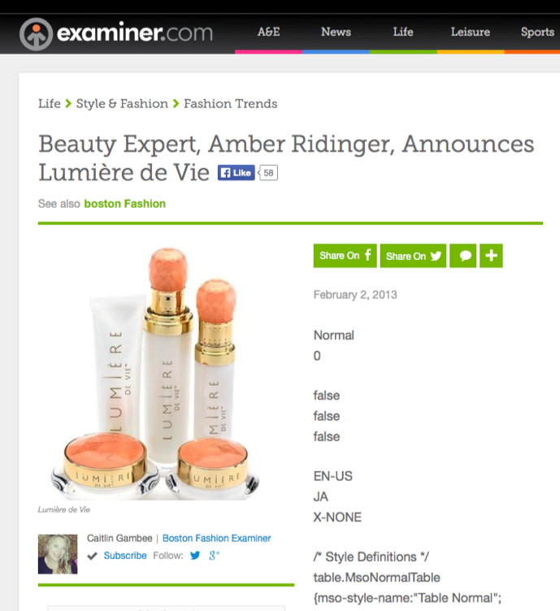
mydailycafe.com
and examiner.com
Lumière de Vie®
極緻研亮護膚系列促進肌膚剔透明亮，煥發年輕再生光彩
Lumière de Vie® promotes a revitalized radiance, improved clarity and younger- looking skin

Slide 11
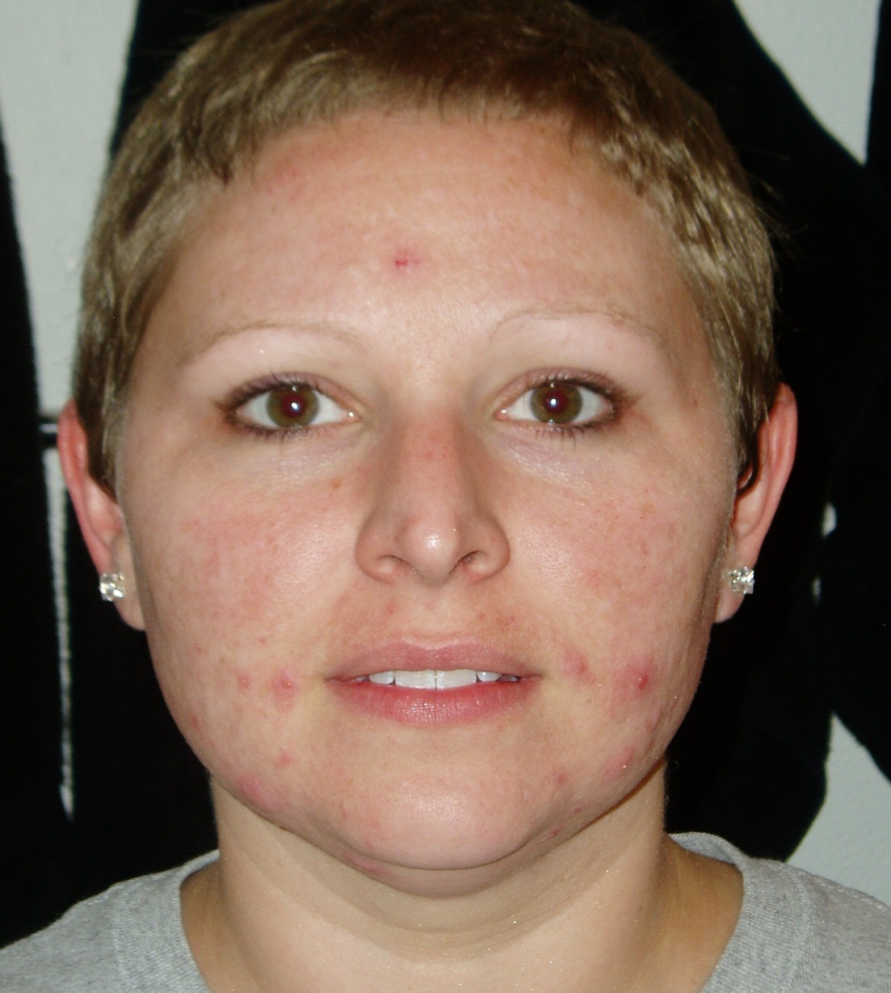
使用前
BEFORE
使用後
AFTER
我用了這些產品幾個月，感覺非常好！
I have been using these products for
months now. I feel gorgeous!
-Sara Bastian
使用Lumière de Vie極緻研亮護膚系列
試用裝
results after using Lumière de Vie Sample Packs
上面展示的並不是必然效果。見證效果因人而異。Results shown above may not be typical. Individual results may vary.

Slide 12
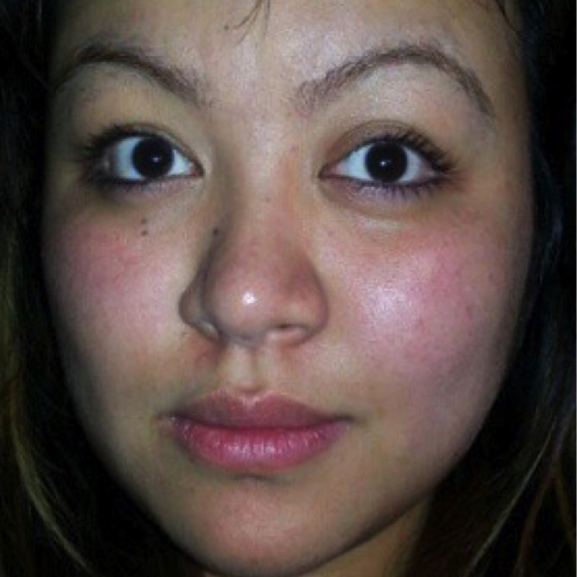
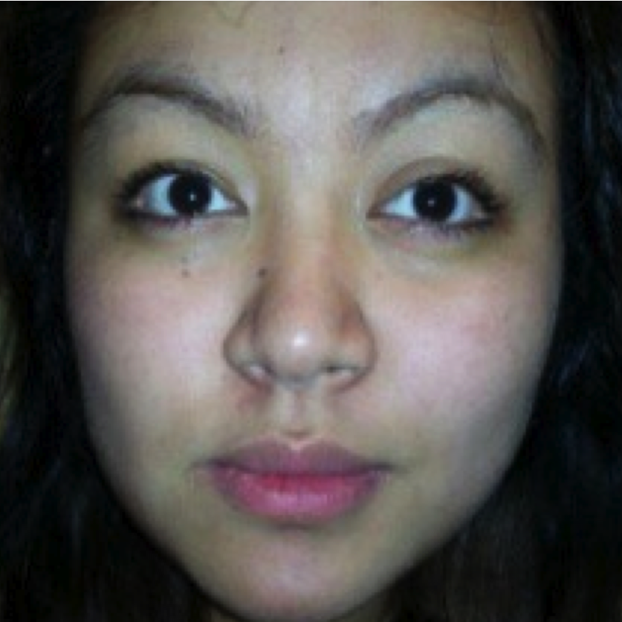
使用前
BEFORE
使用1星期後
AFTER 1 WEEK
上面展示的並不是必然效果。見證效果因人而異。Results shown above may not be typical. Individual results may vary.

Slide 13
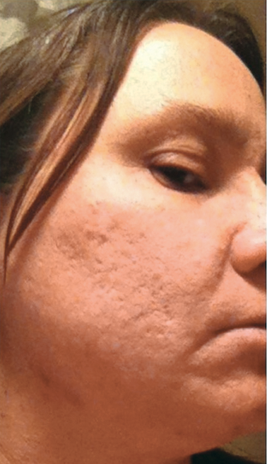
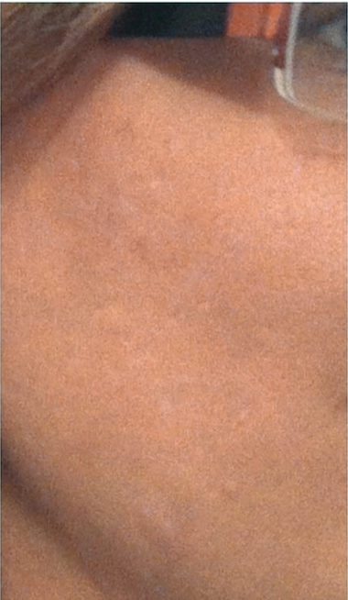
使用前
BEFORE
使用後
AFTER
我的皮膚不再像以前一樣差，Lumière de Vie®極緻研亮護膚系列令我重拾自信！這是使用
2星期後的效果！
I’m no longer
the person with
horrible skin; Lumière de Vie® saved my soul! Here’s a picture after
just 2 weeks!
-Tammie Humble Ellison
使用全套Lumière de Vie極緻研亮護膚系列
results after using the entire Lumière de Vie collection
上面展示的並不是必然效果。見證效果因人而異。Results shown above may not be typical. Individual results may vary.

Slide 14
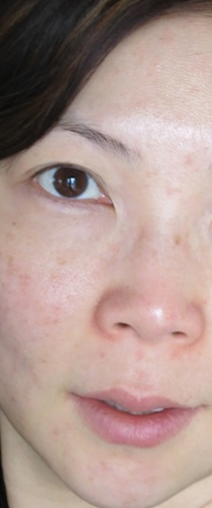
使用前
BEFORE
使用後
AFTER
Lumière de Vie®極緻研亮護膚系列效果很好。只是用了2星期，我就看到改變！
Lumière de Vie® is simply amazing. I saw a Change after only two weeks using of the products!
Mika Takahashi-Chow
使用全套Lumière de Vie
極緻研亮護膚系列
results after using the
entire Lumière de Vie collection
上面展示的並不是必然效果。見證效果因人而異。Results shown above may not be typical. Individual results may vary.

Slide 15
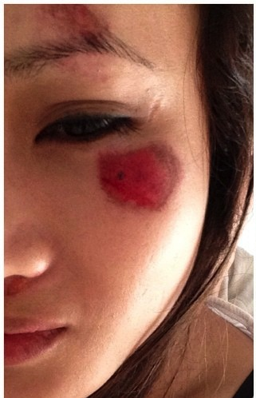
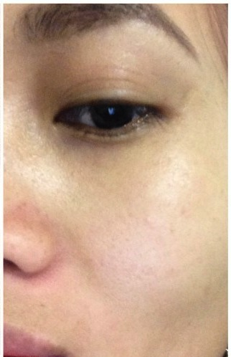
使用前
BEFORE
使用後
AFTER
醒來後我從鏡子裡看到自己的臉時，就像噩夢成真那樣恐怖。
說實話，在這個可怕刻，我很幸運認識到Lumiere De Vie！
Waking up to see my face in the mirror was like I bad nightmare that became reality.
But honestly from this horrible traumatizing moment of my life
I was very fortunate to come across this skincare line Lumiere De Vie!
-Thachtia
使用全套Lumière de Vie極緻研亮護膚系列 Results after using the entire Lumière de Vie collection
上面展示的並不是必然效果。見證效果因人而異。Results shown above may not be typical. Individual results may vary.

Slide 16
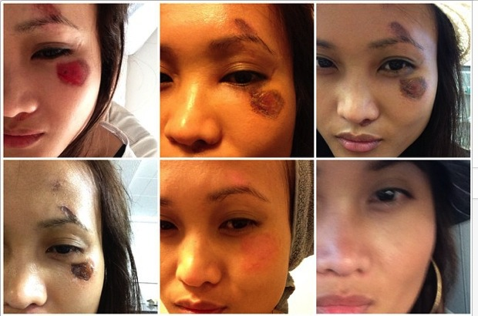
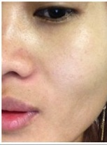
5個月後，你幾乎在我臉上什麼都找不到，右下角的照片就是我的近照！現在我從新愛上我的肌膚了﹗
5 months later, you can barely see anything and the last picture on the bottom right is my most recent picture of TODAY! I AM IN LOVEEEE WITH MY SKIN AGAIN!!
-Thachtia
使用全套Lumière de Vie極緻研亮護膚系列 Results after using the entire Lumière de Vie collection
上面展示的並不是必然效果。見證效果因人而異。Results shown above may not be typical. Individual results may vary.

Slide 17
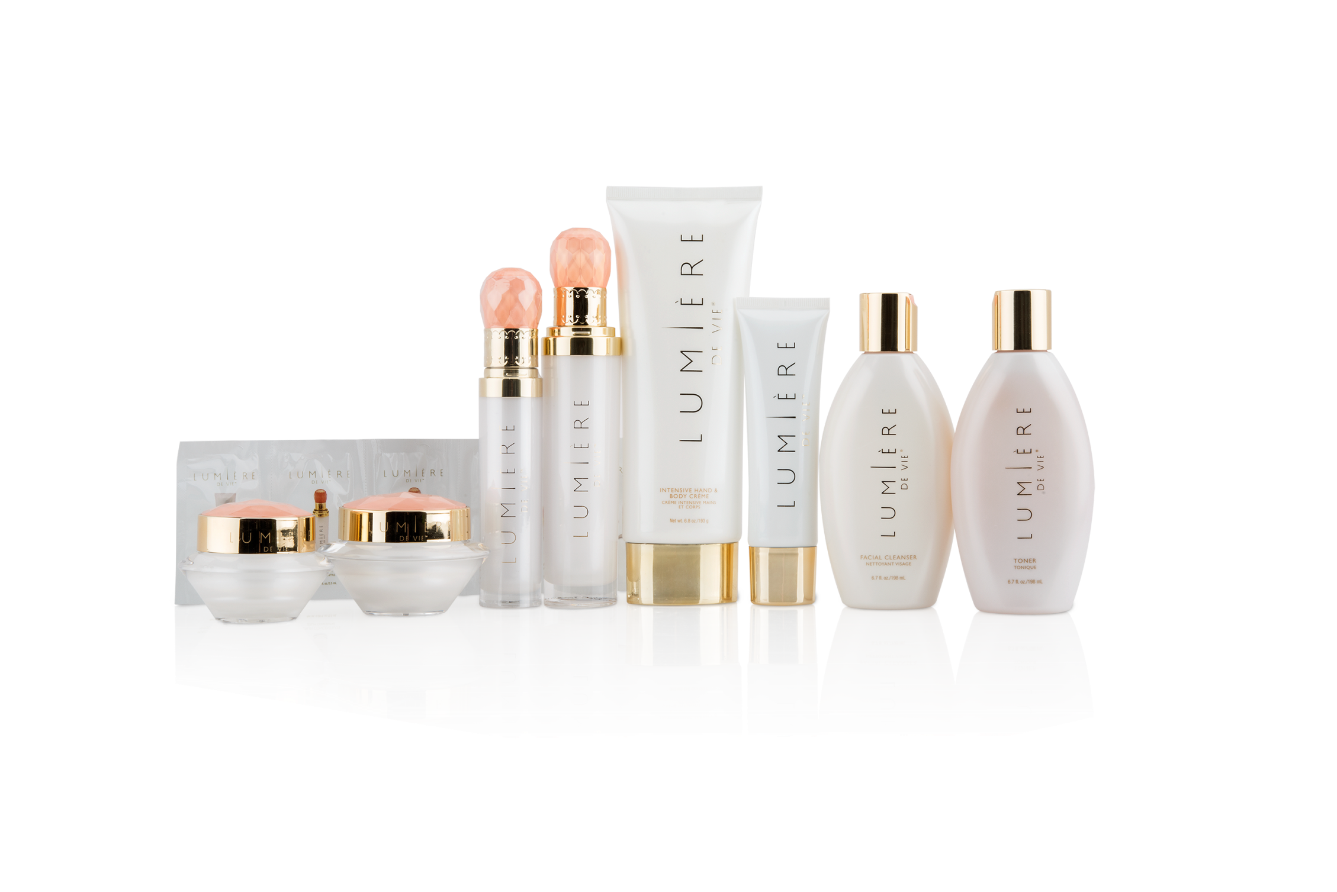
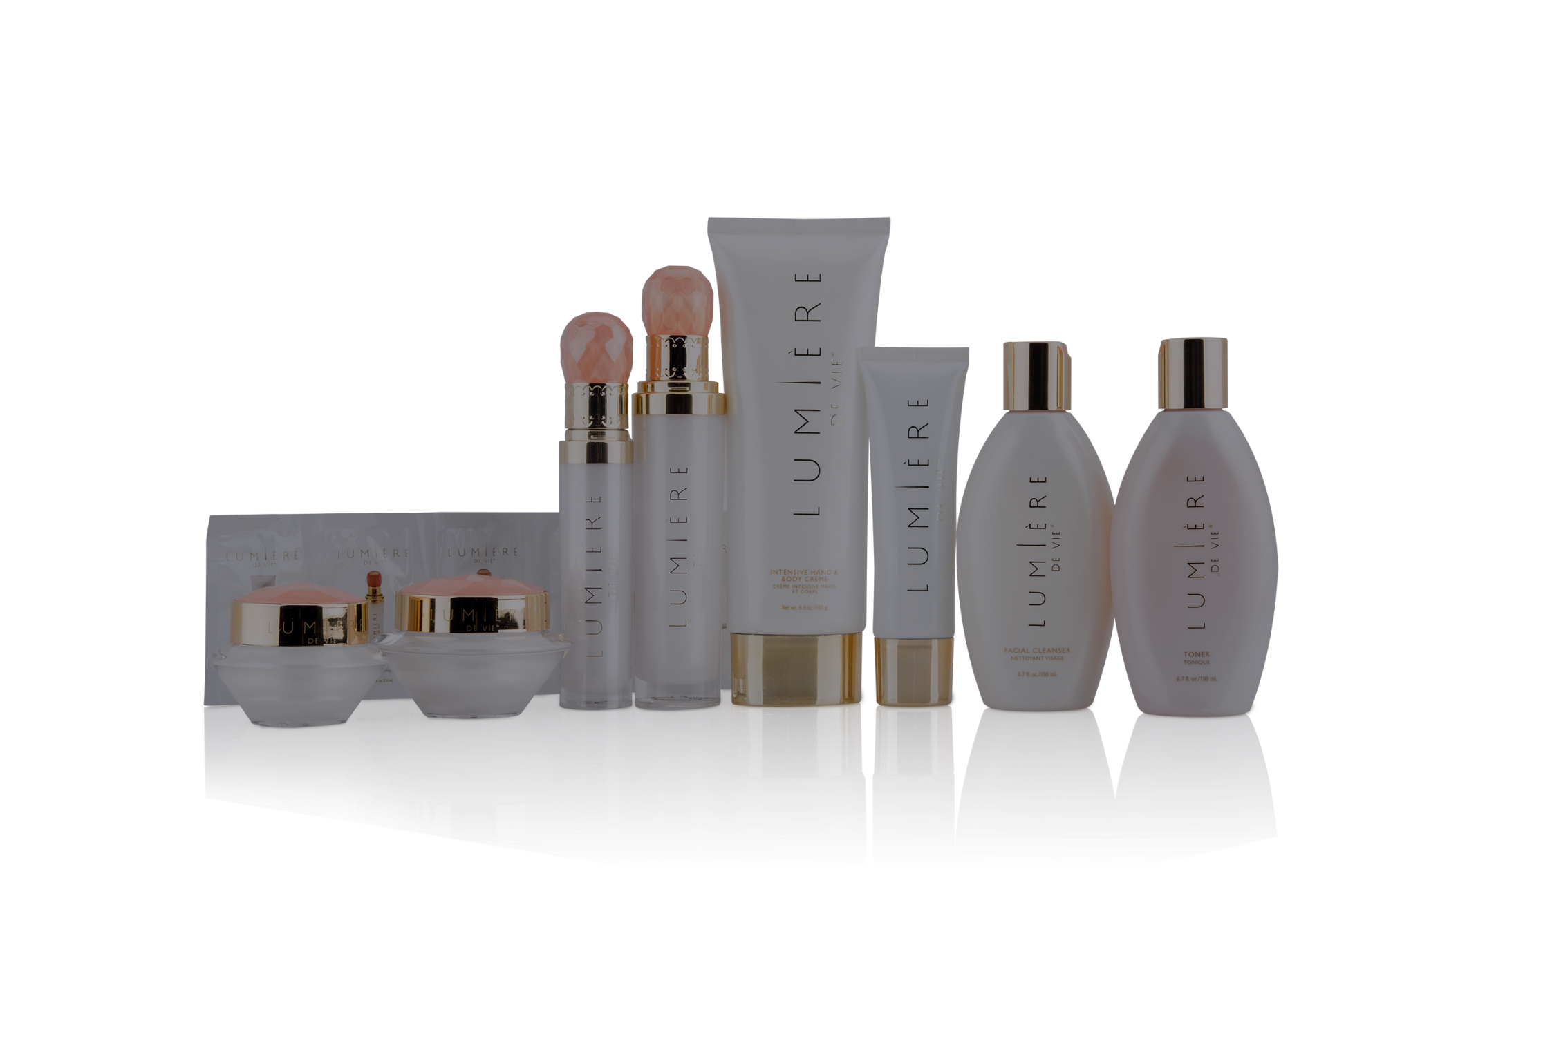
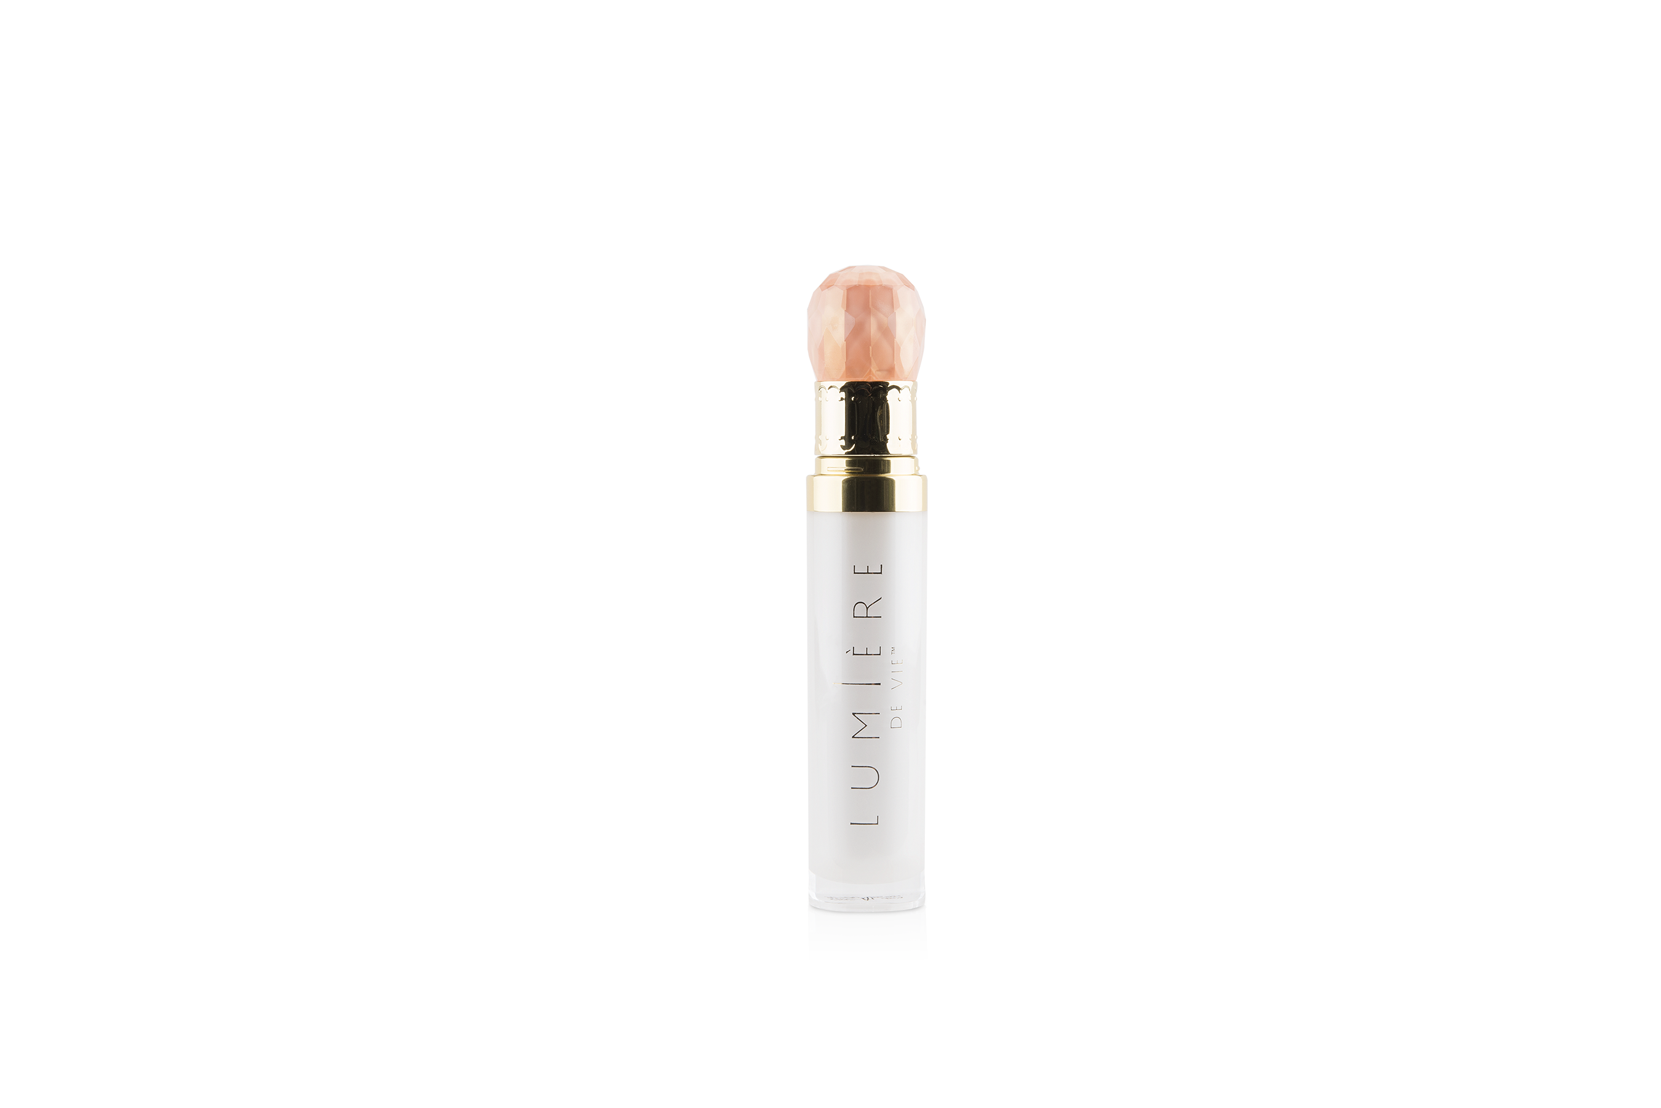

Slide 18
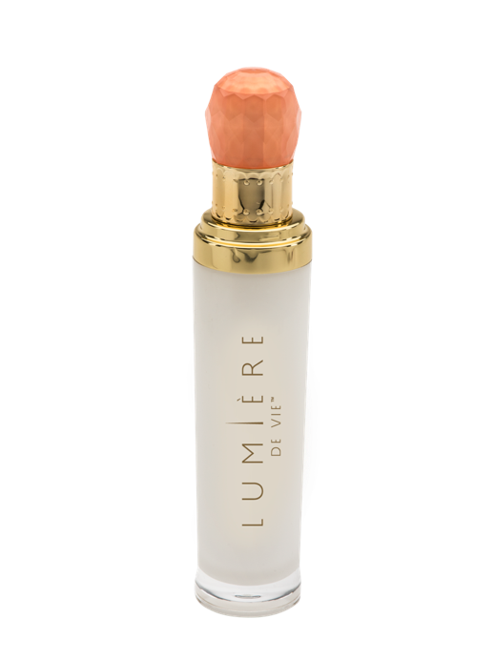
NEODERMYL
瞬間緊緻精華液
短至15日，你可預期看到效果
2星期可看到明顯效果－肌膚更緊緻、顯著皺紋消失
只需2星期，Neodermyl 效果等同到整形外科打一次膠原蛋白針（皺紋深度減15%）
RESULTS YOU CAN EXPECT IN AS LITTLE AS 15 DAYS
Visible results you can see in 2 weeks –skin firmer, deep wrinkles disappear.
In just two weeks Neodermyl gives equivalent results to one needle injection of collagen by a plastic surgeon (-15% wrinkle depth reduction).
Code: HK12212 | UC: $580.00 | SR: 810.00 | BV: 63
最新產品
Newest Addition

Slide 19
NEODERMYL
瞬間緊緻精華液
短至15日，你可預期看到效果
效果持久
一項臨床研究顯示，研究志願者皺紋減淡86%
促進健康肌膚膠原蛋白密度，並支援健康肌膚膠原蛋白網絡
RESULTS YOU CAN EXPECT IN AS LITTLE AS 15 DAYS
Long-lasting benefits.
A clinical study showed reduction in the appearance of wrinkles in 86% of the study volunteers.
Promotes healthy skin collagen density and supports a healthy skin collagen network.
Code: HK12212 | UC: $580.00 | SR: 810.00 | BV: 63
最新產品
Newest Addition

Slide 20
LIFTONIN-XPRESS
瞬間緊緻精華液
預期看到效果
聚合物／微藻成份，提供迅速、實際的緊緻效果，減淡皺紋
EXPECT RESULTS
A polymer/microalgae-based ingredient that provides a rapid, physical tightening effect to reduce the appearance of wrinkles.
Code: HK12212 | UC: $580.00 | SR: 810.00 | BV: 63
最新產品
Newest Addition

Slide 21
LIFTONIN-XPRESS
瞬間緊緻精華液
預期看到效果
使用含3% Liftonin-Xpress啫喱一次，可於1小時內減淡皺紋及改善肌膚柔滑度
EXPECT RESULTS
A single application of a gel containing 3% Liftonin-Xpress reduced the appearance of wrinkles and improved skin smoothness within 1 hour.
Code: HK12212 | UC: $580.00 | SR: 810.00 | BV: 63
最新產品
Newest Addition

Slide 22
ZANTHALENE
瞬間緊緻精華液
你可預期看到效果
含1% Zanthalene的配方於30分鐘內改善眼周粗糙肌膚，暫時減淡皺紋外表
RESULTS YOU CAN EXPECT
A formula containing 1% Zanthalene reduced skin roughness around the eyes within 30 minutes for a temporary reduction in the appearance of wrinkles.
Code: HK12212 | UC: $580.00 | SR: 810.00 | BV: 63
最新產品
Newest Addition

Slide 23
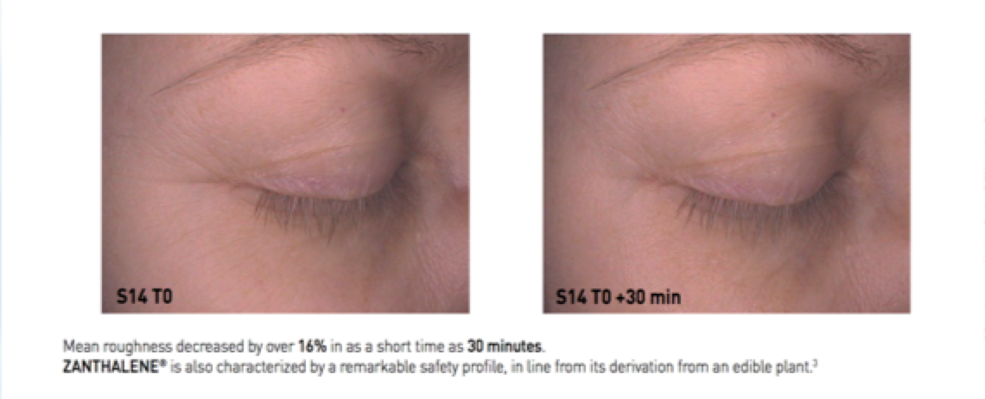
於短至30分鐘內，平均粗糙度減低超過16%。ZANTHALENE®源自可食用植物，因此非常安全。
ZANTHALENE®可即時緊緻提升肌膚。
與其他長效抗皺成份比較，ZANTHALENE獲建議用於即時和長效抗皺及抗衰老配方產品。
建議用量：1%
ZANTHALENE® fully qualifies as an ideal ingredient to provide an immediate lifting effect.
When associated with other anti-wrinkle agents providing a longer term efficacy, it is recommended for the formulation of immediate and long term anti-wrinkle and anti-aging products.
RECOMMENDED DOSAGE: 1%

Slide 24
使用前－9月12日
BEFORE
使用後－10月12日
AFTER
上面展示的並不是必然效果。見證效果因人而異。Results shown above may not be typical. Individual results may vary.

Slide 25
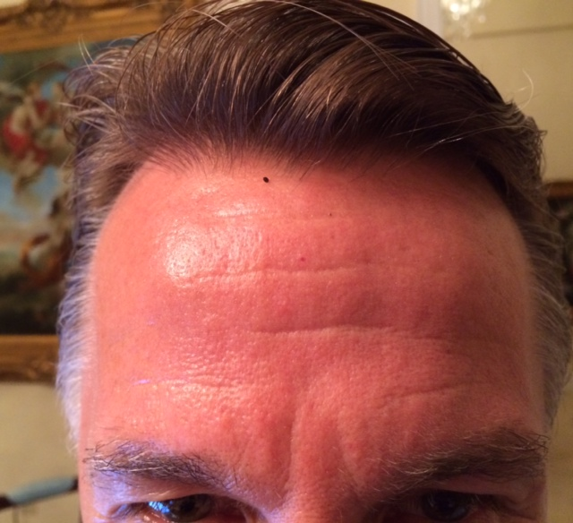
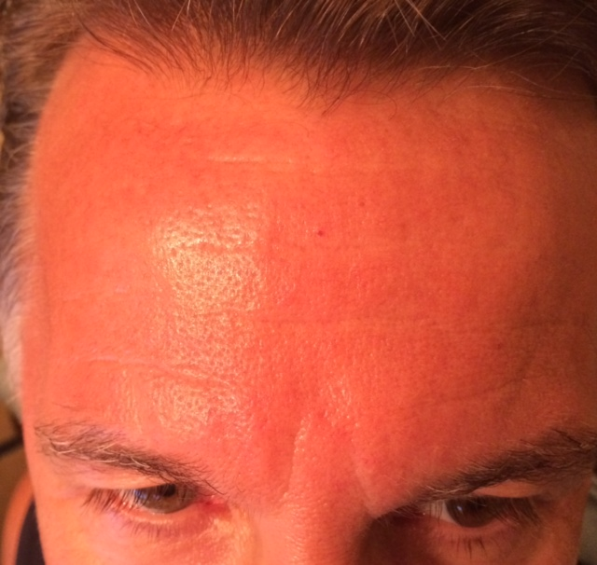
Jim Winker
銷售副總裁（使用前 & 使用後）
Vice President (Before & After)

Slide 26
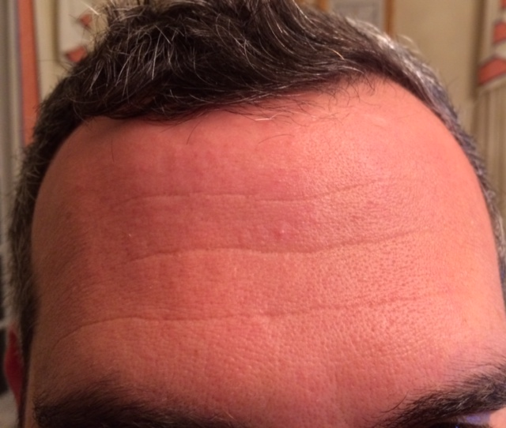
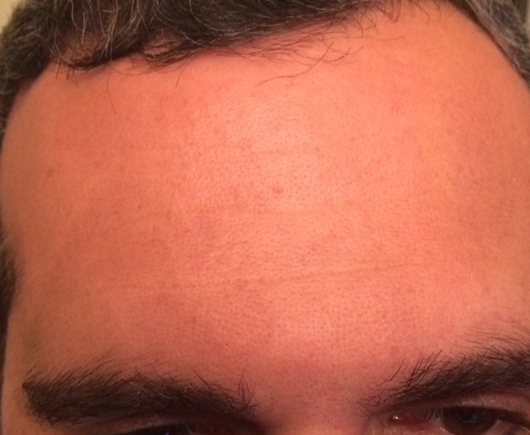
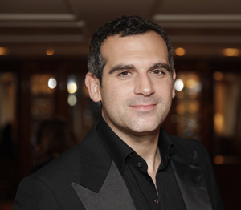
Andrew Weissman
業務開發執行總監（使用前 & 使用後）
Vice President (Before & After)

Slide 27
Motives® 冬日派對
Motives® by Loren Ridinger
Angie Chou
主管經理級 Master Coordinator
四個佣金週期共賺取HK$4,600
HK$4,600 in 4 Commission weeks
本簡報中提到的收入等級純屬舉例說明，無意代表美安香港超連鎖店主的一般收入，也無意表示任何超連鎖店主皆可賺取同等收入。美安香港超連鎖店主的成功與否，取決於其在發展事業時的努力、才能與投入程度。The income levels mentioned in the following presentation are for illustration purposes only. They are not intended to represent the income of a typical Market Hong Kong UnFranchise Owner, nor are they intended to represent that any given Independent UnFranchise Owner will earn income in that amount. The success of any Market Hong Kong Independent UnFranchise Owner will depend upon the amount of hard work, talent, and dedication which he or she devotes to building his or her Market Hong Kong Business.

Slide 30
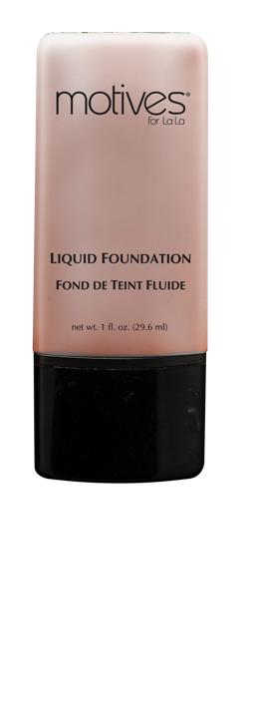
Motives for La La粉底液
Liquid Foundation
易於混和，令肌膚外表完美無瑕
為肌膚保濕，令肌膚看來更平滑
Blends easily and leaves skin looking flawless
Hydrates the skin for a smoother looking complexion
UC: $157.00 | SR: $220.00 | BV: 13.5

Slide 31
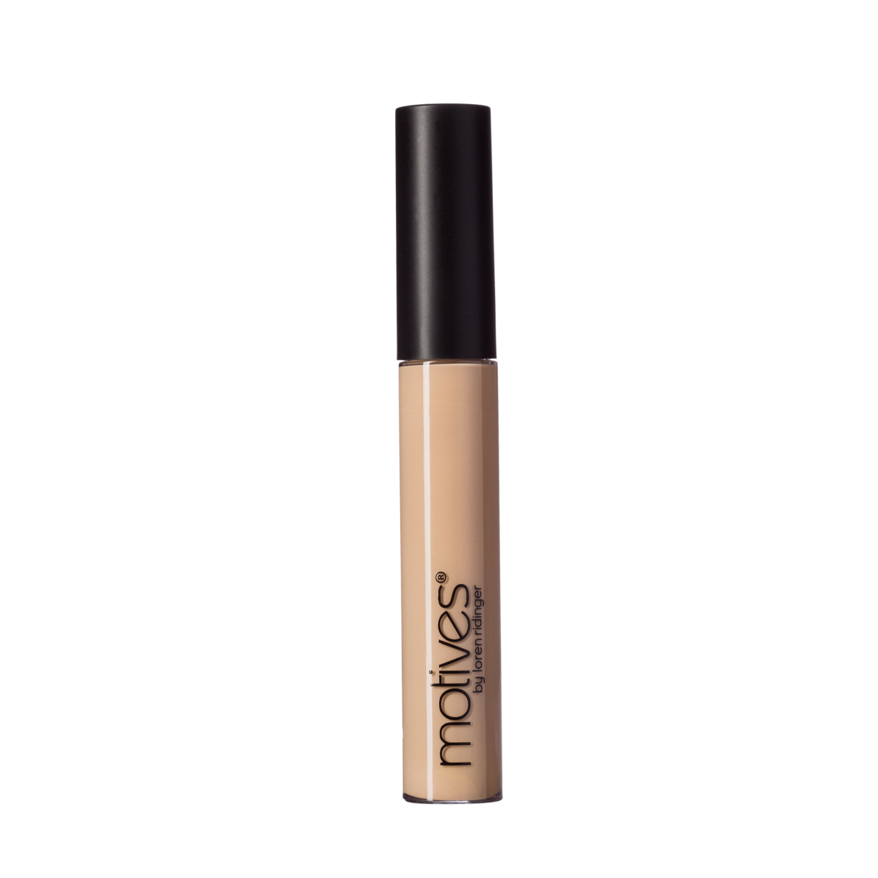
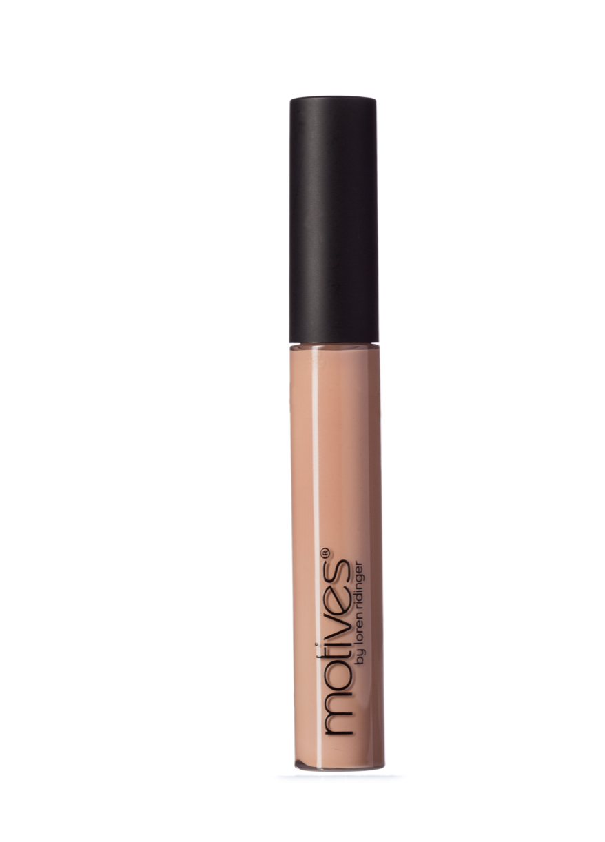
遮瑕液 Liquid Correction Concealer
減少肌膚表面瑕疵
提供中度至全面的持久遮瑕度
含有維他命E可滋潤肌膚
質感柔滑，塗抹時順滑均勻
Minimizes the appearance of skin imperfections Provides medium to full long-lasting coverage
Vitamin E moisturizes skin
Provides smooth and even application
UC: $110.00 | SR: $154.00 | BV: 10

Slide 32
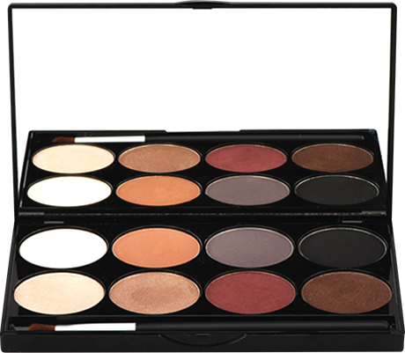
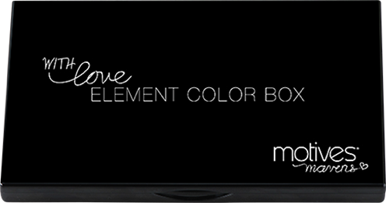
MAVENS 專業眼影組合 Element
Element
UC: $213.00 | SR: $298.00 | BV: 15

Slide 33
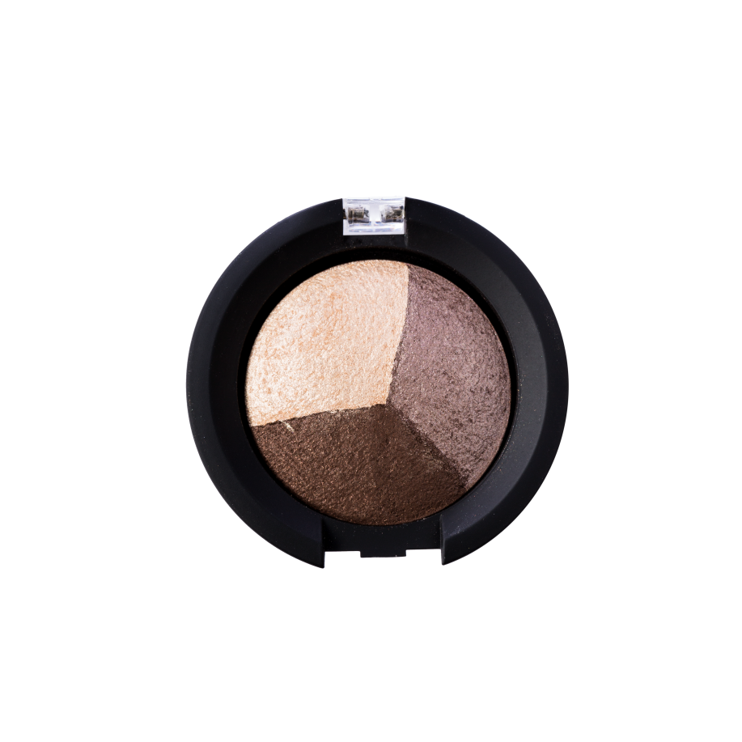
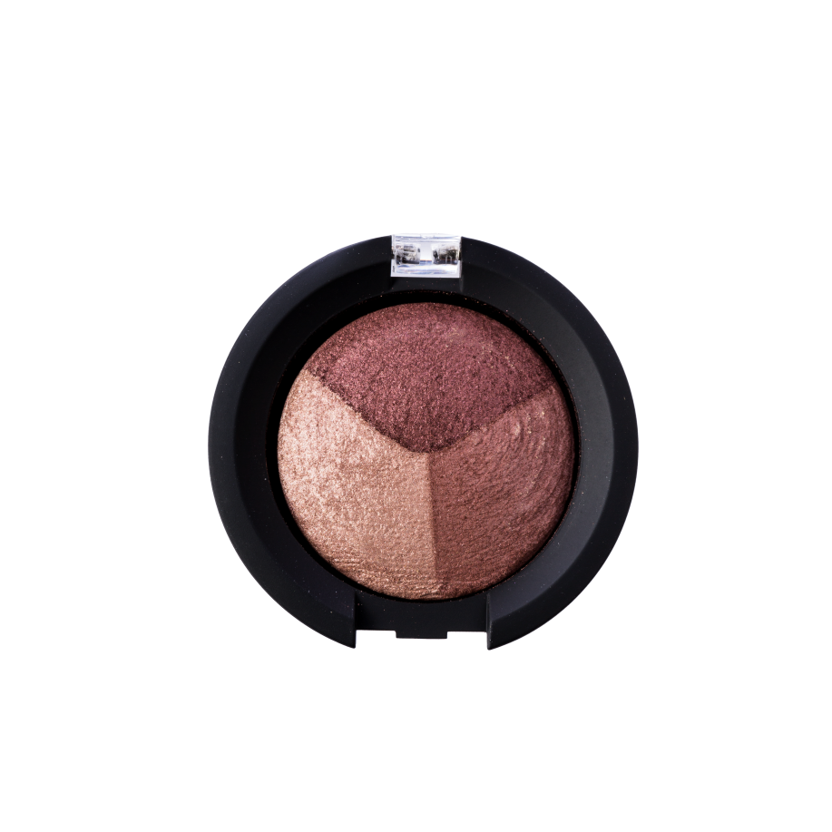
礦物烘焙雙效眼影組合 Baked Eye Shadow Trio
經烘焙程序，質地細緻柔滑
烘焙程序令色彩顯著持久
濕用打造誇張效果，乾用塑造自然日妝
Baked to produce a smooth and silky texture
Highly pigmented and long lasting
Can be applied wet for a more dramatic look, or dry for a more natural daytime look
UC: $165.00 | SR: $228.00 | BV: 14

Slide 34
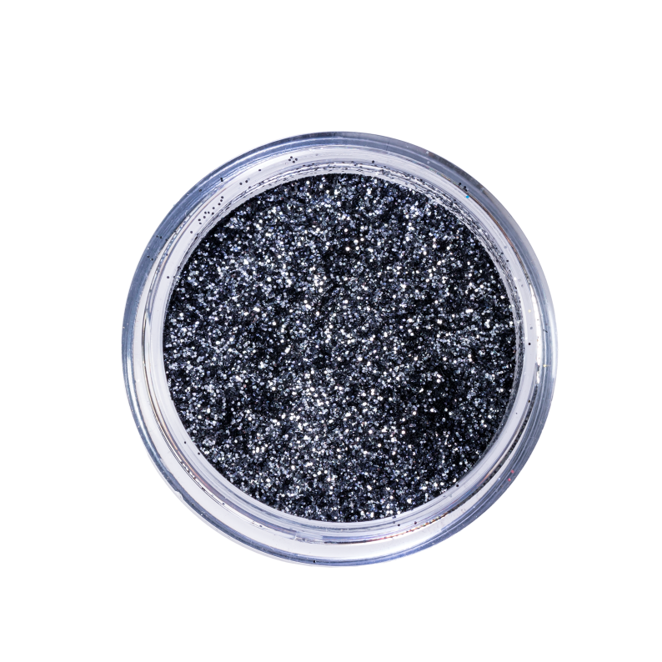
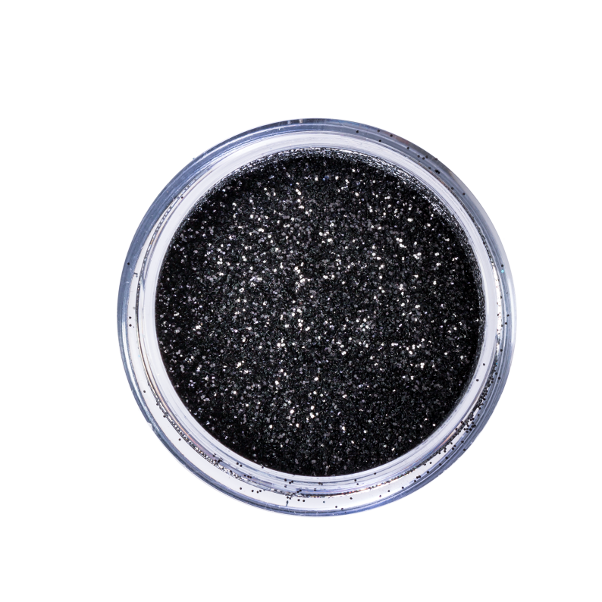
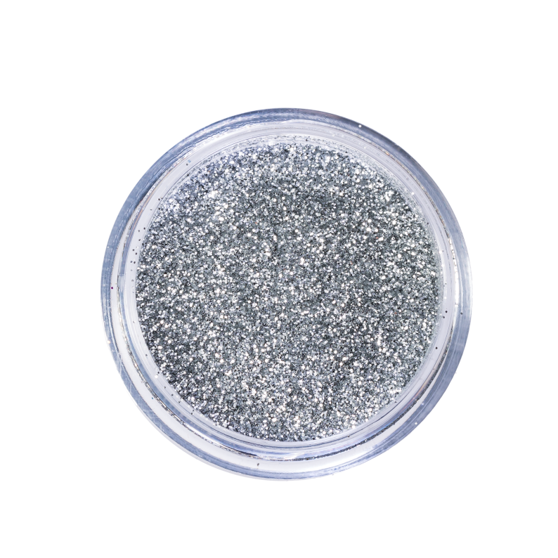
星鑽閃粉 Glitter Pot
增添閃亮目光
幼細且輕盈，為妝容加入色彩
可用於突出任何眼妝
Adds sparkle to the eyes
Lightweight, fine particles add glitter to any makeup
Different colors to accentuate any eye color
UC: $92.00 | SR: $129.00 | BV: 7.5

Slide 35
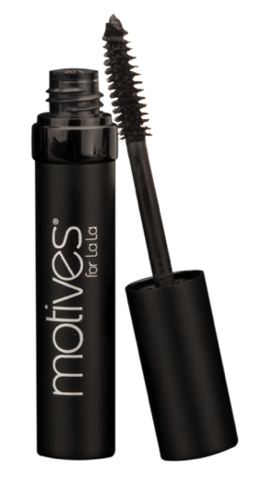
Motives® for La La 礦物豐盈纖長睫毛液 Mineral Volumizing & Lengthening Mascara
配方含豐富礦物成分，塑造濃密、亮麗睫毛
不溶化、不剝落，塑造悅目睫
溫和，適合敏感眼睛
Exquisite rich mineral-based formula builds thick, beautiful lashes with every swipe
Creates smudge-free, flake-free, celebrity lashes
Gentle on sensitive eyes
UC: $126.00 | SR: $177.00 | BV: 9

Slide 36
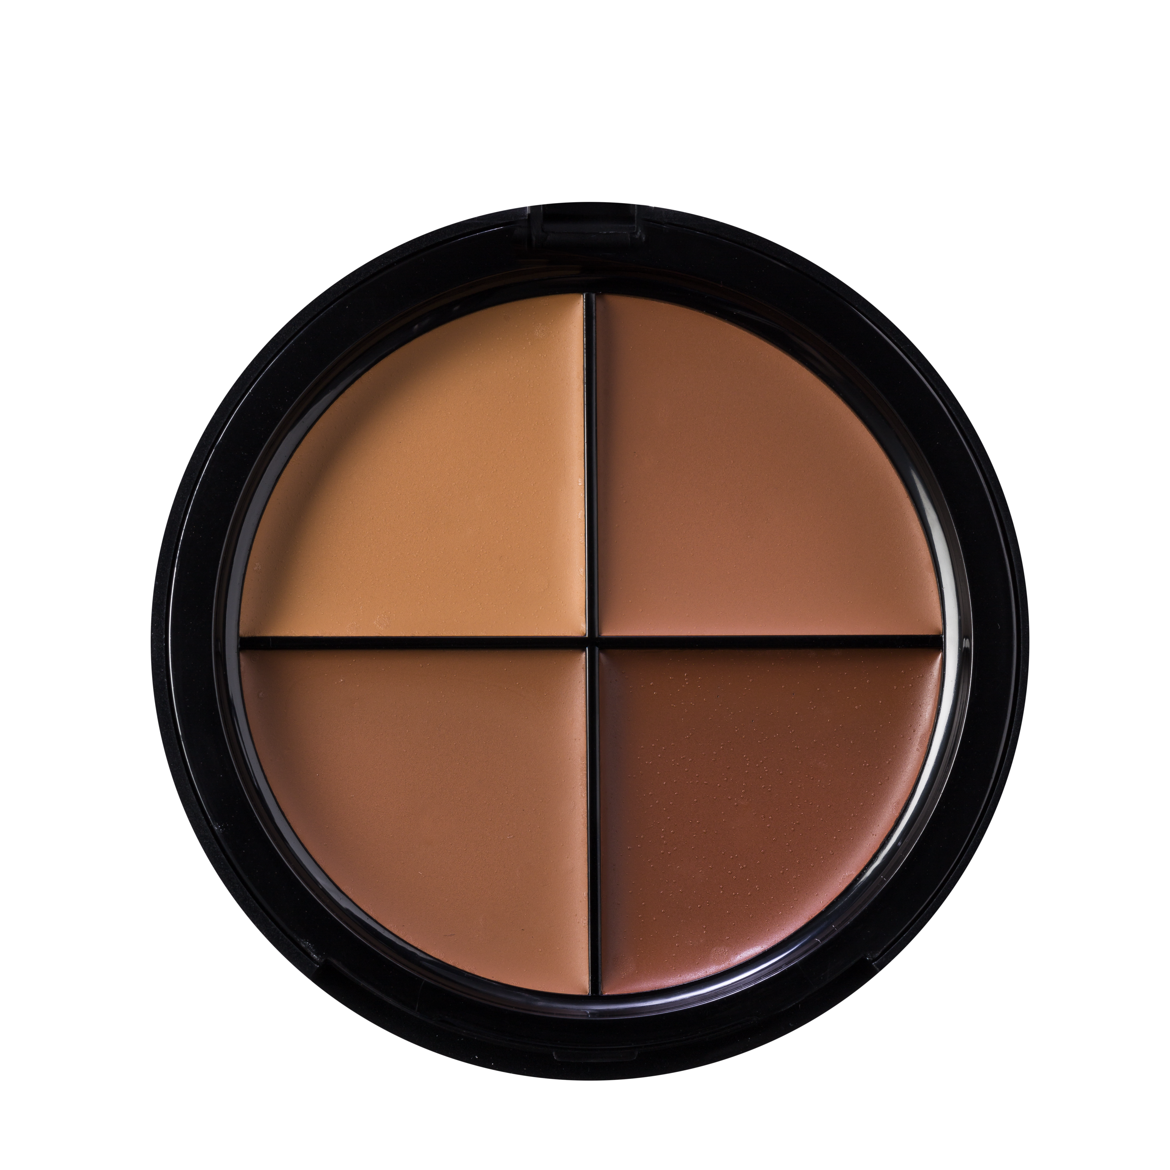
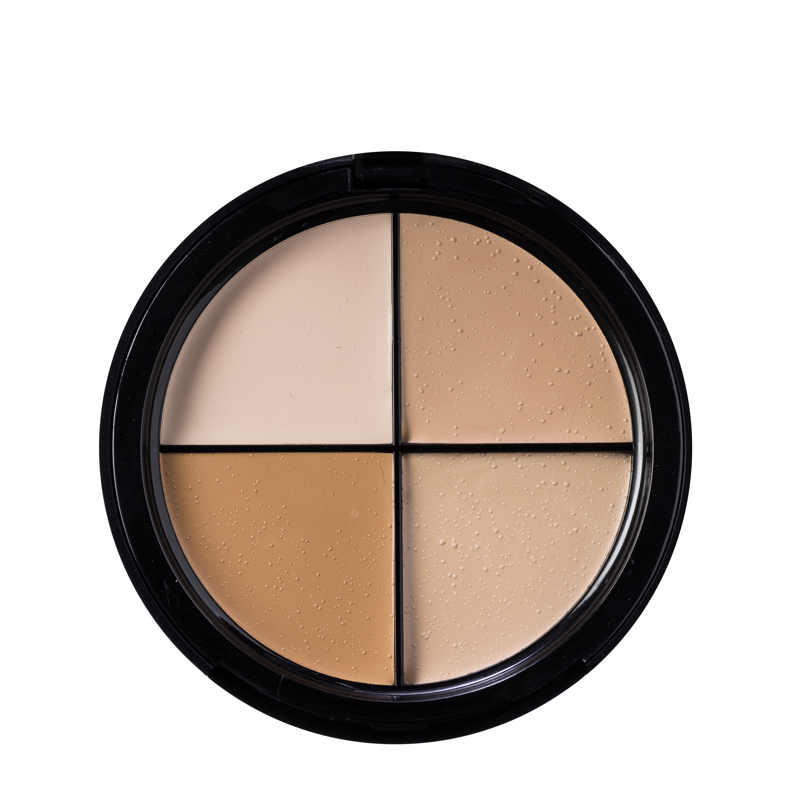
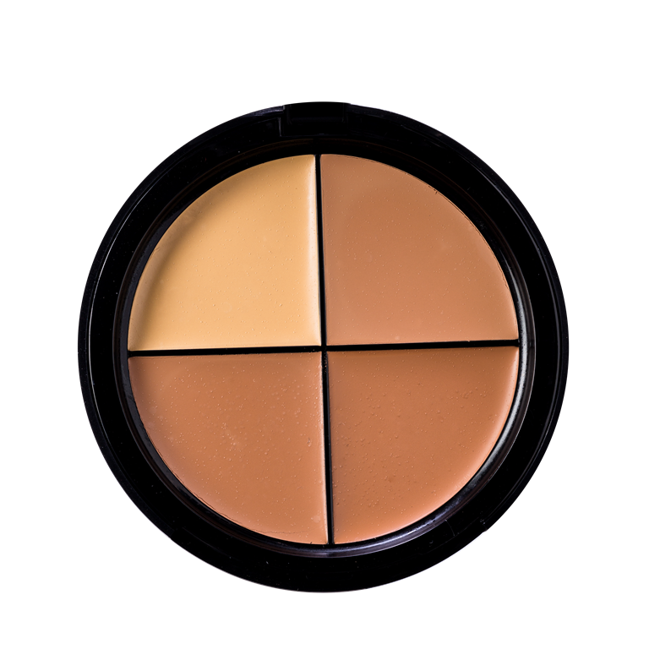
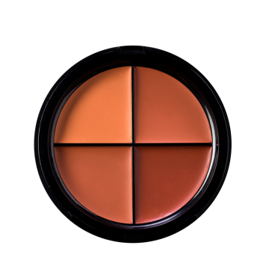
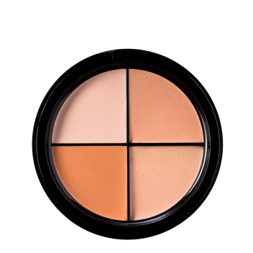
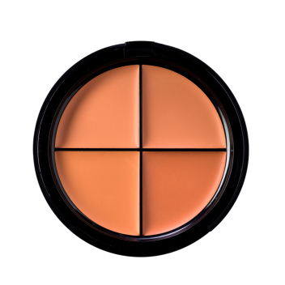
四色膏狀修容組合 Color Perfection Quad
集塑造輪廓、打亮肌膚和遮瑕功能於一身
維他命與油分滋潤和修護肌膚，令肌膚外表柔滑
All-in-one quad to contour, highlight and conceal
Vitamins and oils moisturize and condition for smoother-looking skin
UC: $215.00 | SR: $300.00 | BV: 20

Slide 37
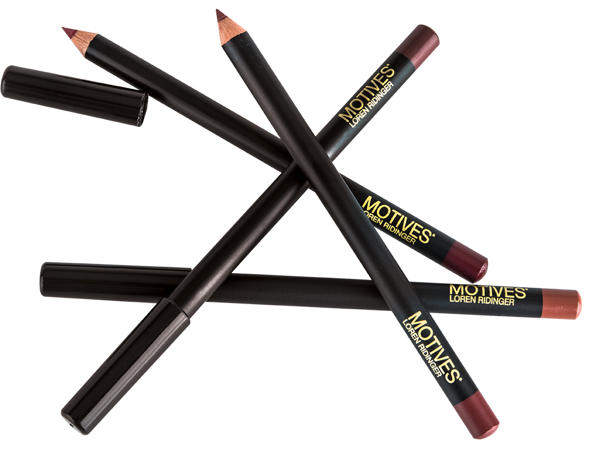
持久色澤唇線筆 Lip Crayon
唇部系列 Lip Products
唇妝組合（9種顏色） Essential Lip Kit (9 colors)
UC: $213.00 | SR: $300.00 | BV: 20
UC: $109.00 | SR: $153.00 | BV: 8.5

Slide 38
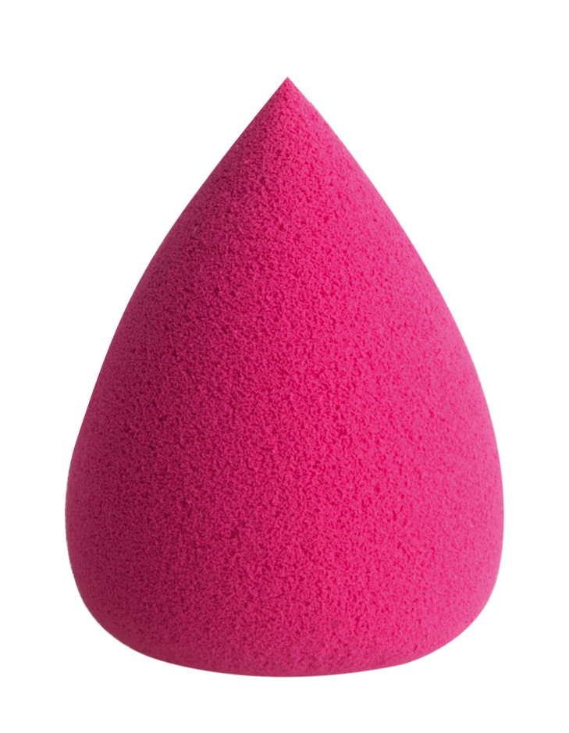
全效化妝綿 Dual Blending Sponge
獨特的水滴設計
不會過量沾取產品，只需少量產品已能塑造無瑕妝容
乾濕兩用，適用於任何質地的化妝品
Unique curved shape
Absorbs less product for a more even coverage
Can be used wet or dry in all makeup formulations
UC: $85.00 | SR: $119.00 | BV: 7

Slide 39
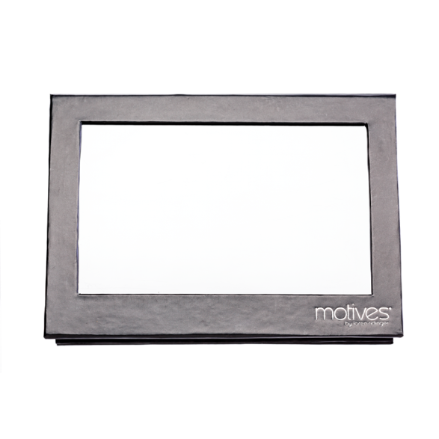
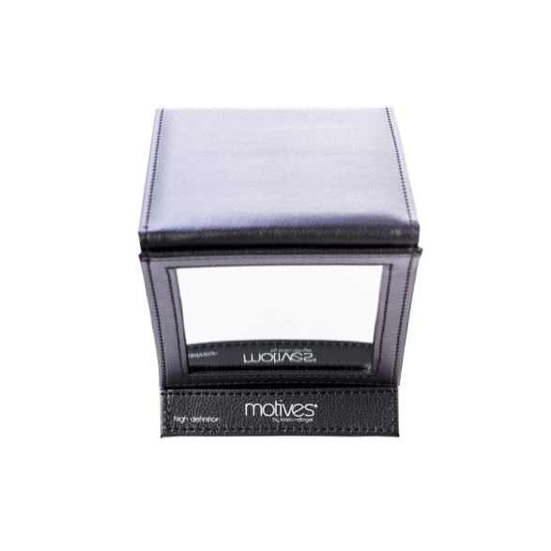
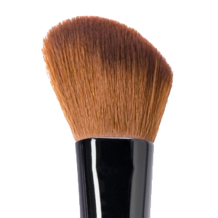
斜角眼線掃 Shadow Angled Eyeliner Brush
工具 Tools
極緻眼影掃 Makeup Detailing Brush
申縮兩用眼部及唇掃 Makeup Retractable Lip
& Eye Brush
UC: $92.00 | SR: $129.00 | BV: 7
UC: $68.00 | SR: $95.00 | BV: 4
UC: $67.00 | SR: $94.00 | BV: 4
面部輪廓掃 Makeup Cheek Contour Brush
彩妝盒 Shadow Box
彩妝鏡 Makeup Mirror
UC: $75.00 | SR: $105.00 | BV: 3
UC: $79.00 | SR: $111.00
UC: $140.00 | SR: $196.00 | BV: 12

Slide 40
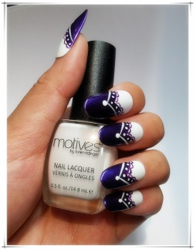
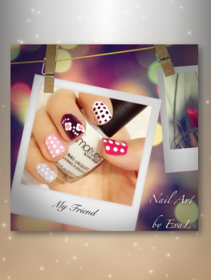
Motives® 持久絕色甲油創意甲藝比賽一最後五強
Creative Nail Art Contest – Top 5 Finalists
到美安香港Motives by Loren Ridinger 彩妝系列 Facebook專頁一https://www.facebook.com/motivesmhk
挑選及「讚好」 你最喜愛的甲藝作品
*投票截止時間：11月15日晚上11時59分
Visit MHK Motives by Loren Ridinger® Official Facebook Fan Page - https://www.facebook.com/motivesmhk
Select and ‘LIKE’ your favorite Motives® Nail Art
*Deadline for Voting: November 15, 2014 11:59 p.m.
Visit MHK Motives by Loren Ridinger® Official Facebook Fan Page - https://www.facebook.com/motivesmhk
Select and ‘LIKE’ your favorite Motives® Nail Art
*Deadline for Voting: November 15, 2014 11:59 p.m.

Slide 41
網上彩妝派對

Slide 42
網上彩妝派對
最新互動銷售工具
ONLINE PARTY
NEW INTERACTIVE TOOL
讓任何人都能夠在網上
舉辦Motives彩妝派對
Allows anyone including you to host a Motives Cosmetics party – ONLINE.
只需數秒便可設定
你的彩妝派對
Within seconds you can set up your party
提供派對主題
Give the Party a theme
選擇派對舉辦時段
Choose the number of days for the party to last

Slide 43
網上彩妝派對
最新互動銷售工具
ONLINE PARTY
NEW INTERACTIVE TOOL
選擇你想向客人推薦的
彩妝類別
Choose the category you wish to feature when customers go to the website to see your party
選擇 12 款在派對中介紹的妝容
Choose up to 12 looks to feature at the party
透過歡迎電郵內的派對連結分享至Facebook或電郵給朋友
Share your party link that is in your welcome email on Facebook and email

Slide 44
MOTIVES®
彩妝系列
最新互動
銷售工具
立即舉辨派對
Create Your Party Now!

